Slide 1
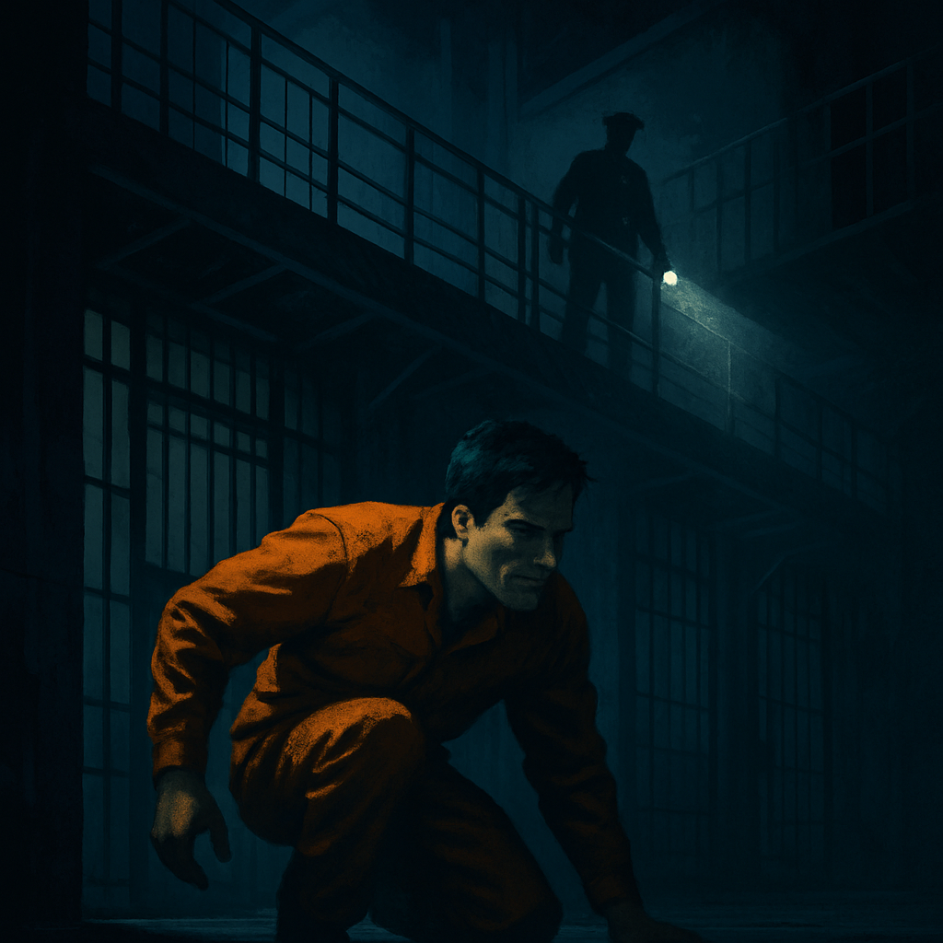
Jail Break Game Proposal
CS 6457 Titan Tech

Slide 2
What is Jail Break
A wrongly accused inmate. A high-tech prison. One chance to escape.
Objective:
Using the art of silence and stealth, the player must plan and escape while avoiding guards, creating distractions from a dynamic, high-security prison.
Core Experience:
Tension of being hunted
Planning for perfect escape
Adaption to dynamic environment

Slide 3
Game Mechanics
Stealth Movement
Distration System
Detection
Fail States
Noise levels for various actions: Walk, Running, Crouch, Hide
Use noise/objects to manipulate guards attention and change guard routes
limited visibility, change state when player is visiable,
reaction to environment and sound
Player can have N number of tries to esacpe
Guard AI
Objectives
Fixed patrols routes in patrol state,
chase and track when detected
Must retrieve key/code or other objectives before escaping

Slide 4
Game Loop
Chase Mode
Observe Guards
Distract or Lure
Escape
If detected by guards, they will track and chase you
Watch and analyze guard routes and movement
Throw objects or cause noise to mislead guards.
Escape from the prison and win
Objective Complete
Caught: Restart or Game Over
Hide or Break LOS
Plan Movement
Move Undetected
Detected
Hide or outmaneuver the guard in any way
Choose a safe path and time your move
Walk, run, hide, or crawl depending on situation to stay undetected
Undetected
Evaded

Slide 5
Game Elements
Characters
UI
Environment
Rules
Player: Inmate
Run (nosiy)
Walk (moderately noisy)
Crouch/Crawl (quiet)
Hide (quiet)
Interact
AI: Guards
Guards have fixed routes
When player enters vision cones, the guard becomes alerted
If guard catches player, the player returns to cell
Player can break line of sight/hide
Include Mini-map
Show alert indicator if spotted
Detection percentage indicator
Status message of events
Menu options
Play
Difficulty select
Rules
Controls/settings
Players can interact with surroundings:
hide under tables or objects
Collect keys/code
Pick up and throw objects to create noise
Activate sound triggering distractions
Game End Conditions
If caught, restart the level/return to cell (N tries)
If all objective completed and reach the escape door – Win/beat level
There can be multiple escape points or win conditions (repayable)
Optional Features:
Difficulty modes
Level progression and scaling
Add special objectives and randomization for dynamic levels
Various and dynamic levels
Items
Some items can include:
Escape door key/code
Throwables: Rocks, coins, chains, bottles
Enhancements – map, flashlight, sneakers

Slide 6
Technial Plan / Roles
Role | Description
Programming 1 | Player controls, movement and interaction systems
Programming 2 | Guaurd (AI), patrol state, vision and detection, chase state, reaction with sound
Artist | Basic character models, obstacles, interactables/ collectibles, level structures models
Level Designer | Prison map layout, hiding spots, mutliple escape routes, realism of game, walkable areas

Slide 7
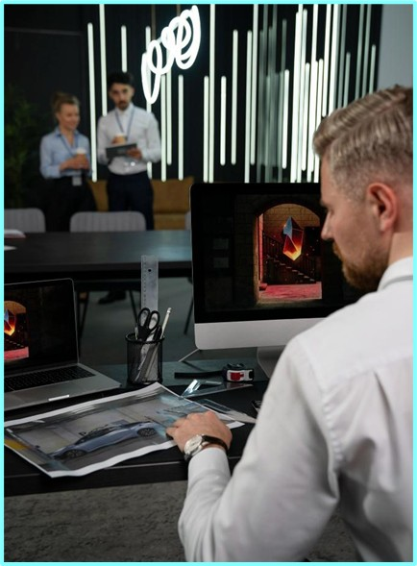
Development Challenges
Guard AI & Patrol Behavior
Implementing believable patrols,
Vision cones
Chase logic and state
Interaction with sound (investigation state)
Stealth Mechanics and Line of Sight
Detecting when guards can see player
Balance performance with realism with multiple guards
Level Design and Difficulty Balance
Fun, enjoyable player experience
Tuning guard placements, sightlines and map layout
Realistic with good game feel
Player Control and Feedback
Smooth animation transitions and indicators
Responsive and clear movement
Good feedback when hidden or spotted

Slide 8
Prototype Preview

Slide 9
Everything Below is hidden (used for styling)

Slide 10
Game Mechanics
This is a slide structure based on a portfolio
You can delete this slide when you’re done editing the presentation
Fonts | To view this template correctly in PowerPoint, download and install the fonts we used
Used and alternative resources | An assortment of graphic resources that are suitable for use in this presentation
Thanks slide | You must keep it so that proper credits for our design are given
Colors | All the colors used in this presentation
Infographic resources | These can be used in the template, and their size and color can be edited
Customizable icons | They are sorted by theme so you can use them in all kinds of presentations
For more info: SLIDESGO | BLOG | FAQS
You can visit our sister projects: FREEPIK | FLATICON | STORYSET | WEPIK | VIDEVO

Slide 11
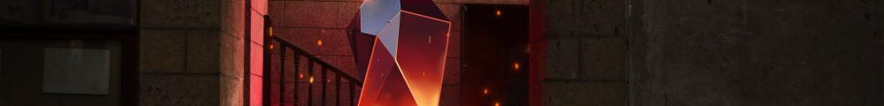
Table of contents
My work area
What I do
01
02
My experience
My work
03
04
You can describe the topic of the section here
You can describe the topic of the section here
You can describe the topic of the section here
You can describe the topic of the section here

Slide 12
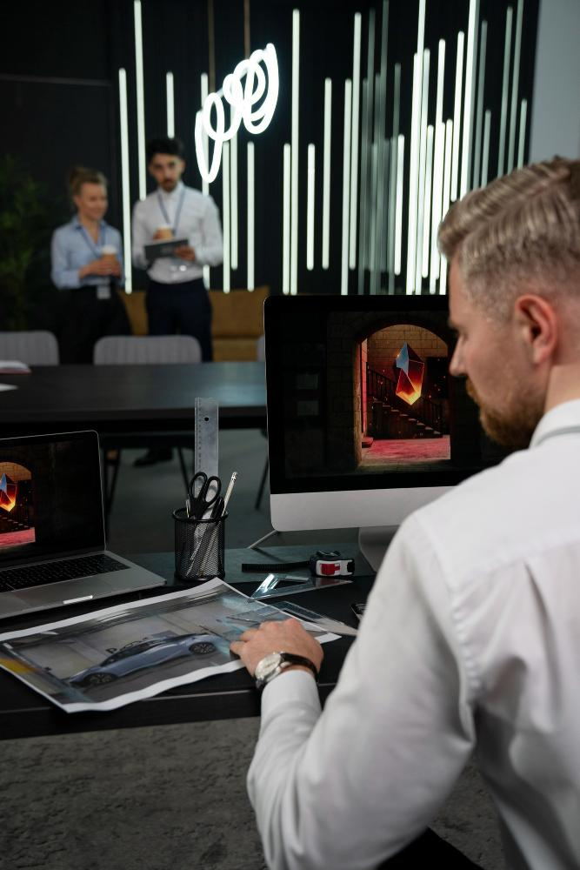
About me
You can give a brief description of the topic you want to talk about here. For example, if you want to talk about Mercury, you can say that it’s the smallest planet in the entire Solar System

Slide 13
Values
Design
UX
UI
Mercury is the closest planet to the Sun and the smallest of them all
Venus has a beautiful name and is the second planet from the Sun
Despite being red, Mars is actually a cold place. It’s full of iron oxide dust

Slide 14
What I do
Venus
Jupiter
Mars
Saturn
Venus is the second planet from the Sun
It’s the biggest planet in the Solar System
Despite being red, Mars is a cold place
Saturn is a gas giant and has several rings

Slide 15
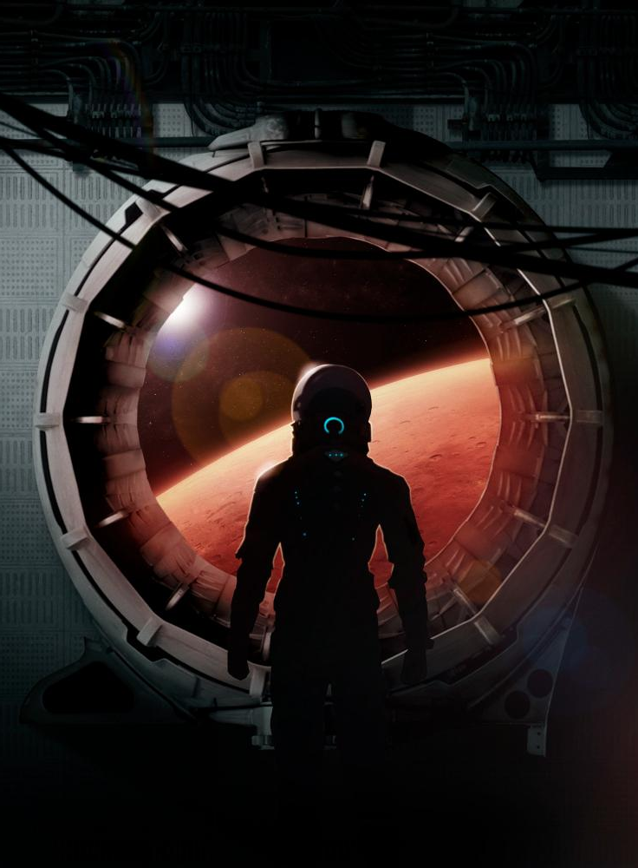
Project 01
Do you know what helps you make your point clear?
Lists like this one:
They’re simple
You can organize your ideas clearly
You’ll never forget to buy milk!
And the most important thing: the audience won’t miss the point of your presentation

Slide 16
My resume
Education
Projects
2014 - 2015
Project 01
Mercury
Sun
It’s a small planet
The Sun is a big star
2015 - 2016
Project 02
Venus
Jupiter
Venus is a hot planet
It’s a big planet
2016 - 2017
Project 03
Mars
Neptune
Mars is a cold place
Neptune is far away
Skills
Leadership
Security
Efficacy
Speed
Intuition

Slide 17
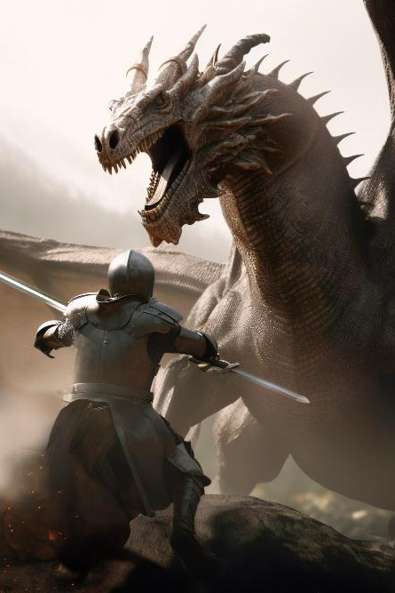

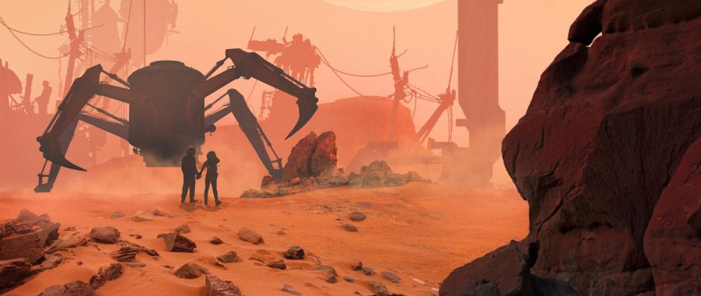
01
My work area
You can enter a subtitle here if you need it

Slide 18
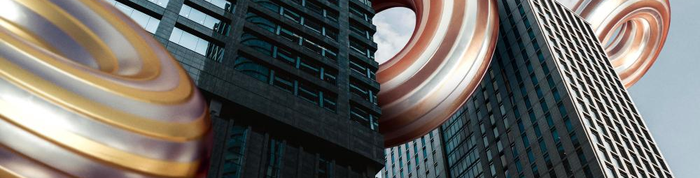
Awesome words

Slide 19
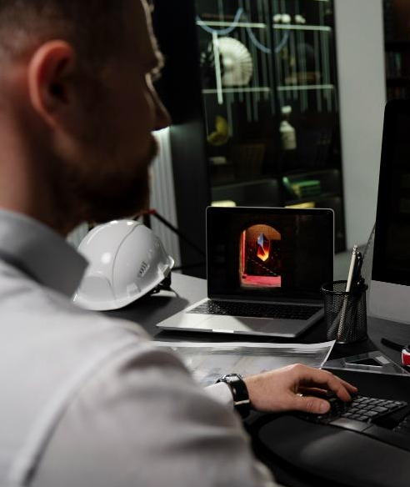
02
What I do
You can enter a subtitle here if you need it

Slide 20
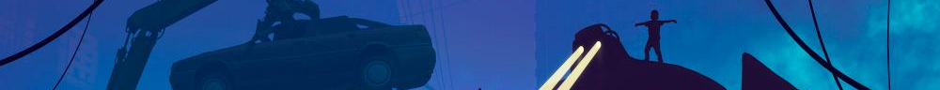
Project 02
VR
Game
Mercury is the closest planet to the Sun and the smallest one in the Solar System
Venus has a beautiful name and is the second planet from the Sun. It’s really hot there

Slide 21
Achievements and skills
Mercury
Venus
Mars
Jupiter
Saturn
Neptune
It’s the closest planet to the Sun
Venus is the second planet from the Sun
Mars is actually a very cold place
Jupiter is the biggest planet of them all
It’s composed of hydrogen and helium
It’s the farthest planet from the Sun

Slide 22
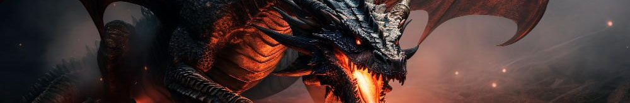
—Someone Famous
“This is a quote, words full of wisdom that someone important said and can make the reader get inspired.”

Slide 23
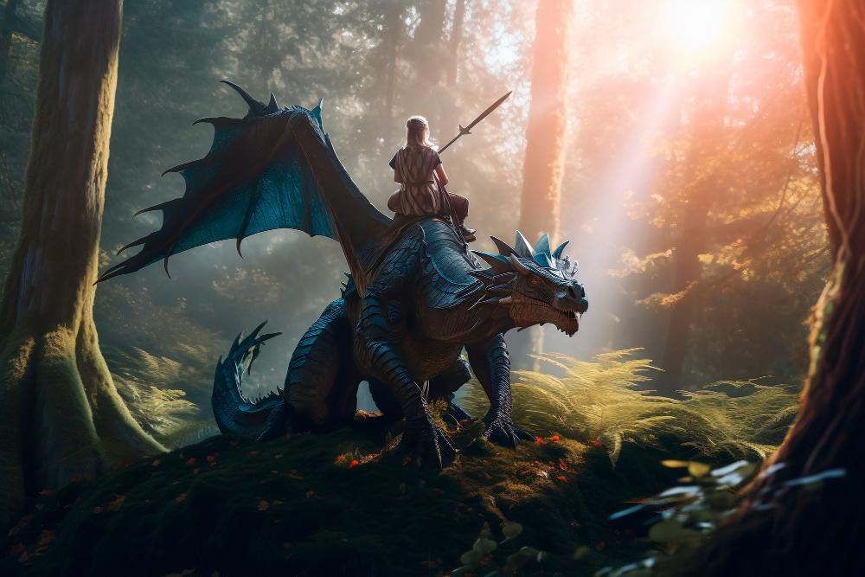
A picture is worth a thousand words

Slide 24
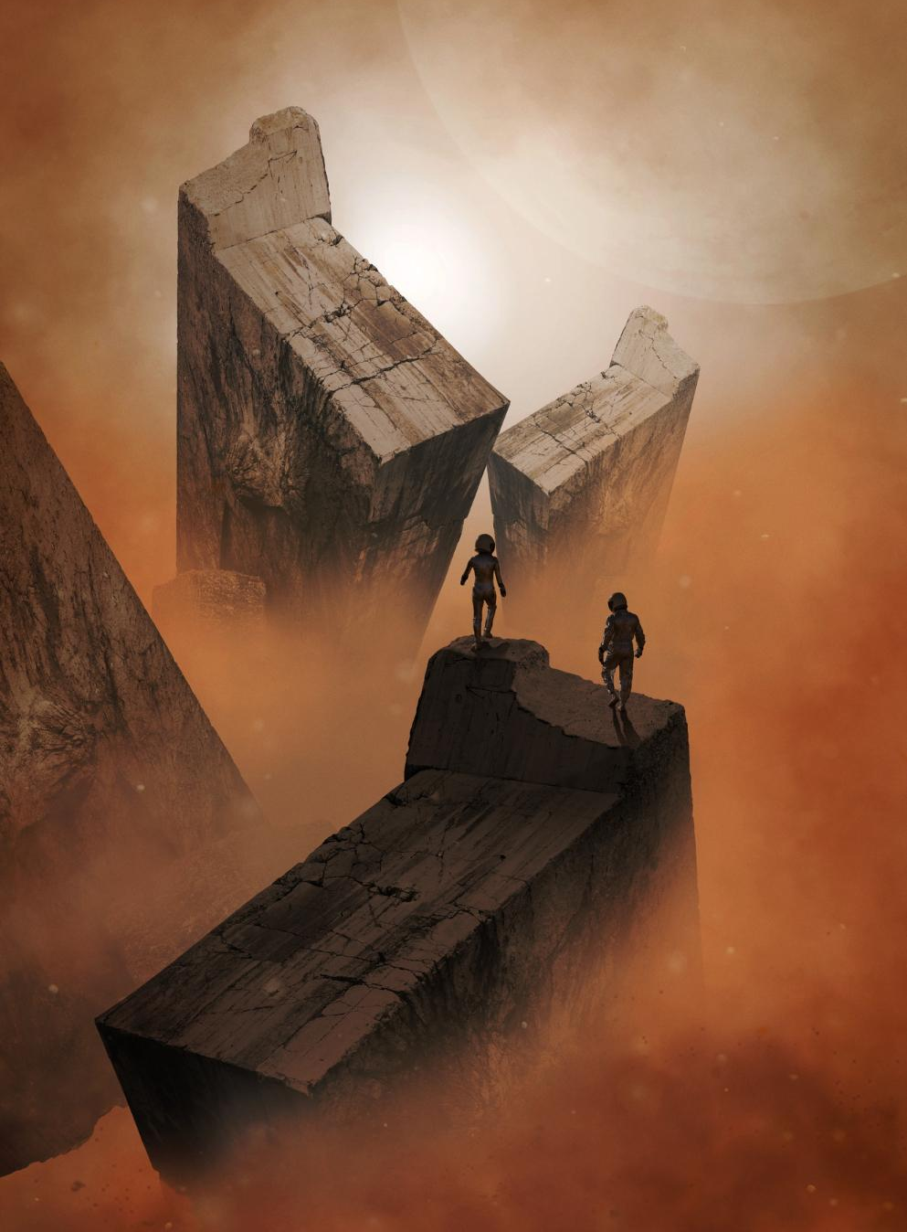
To reinforce the concept, try using an image
Images reveal large amounts of data, so remember: use an image instead of a long text. Your audience will appreciate it

Slide 25
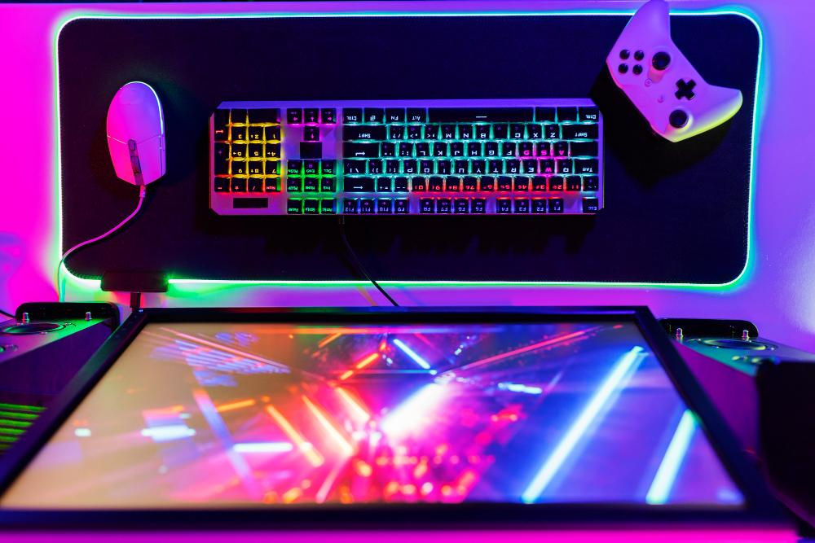
150,000
Big numbers catch your audience’s attention

Slide 26
9h 55m 23s
333,000
386,000 km
Jupiter's rotation period
The Sun’s mass compared to Earth’s
Distance between Earth and the Moon

Slide 27
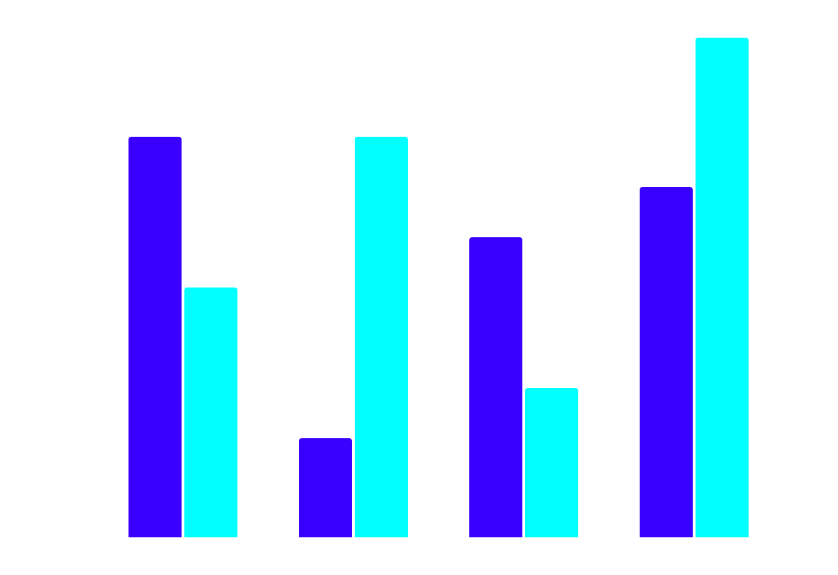
This is a graph
Jupiter
It’s the biggest planet in the Solar System
Saturn
Saturn is a gas giant and has several rings
Mars
Sun
Mercury
Venus
Follow the link in the graph to modify its data and then paste the new one here. For more info, click here

Slide 28
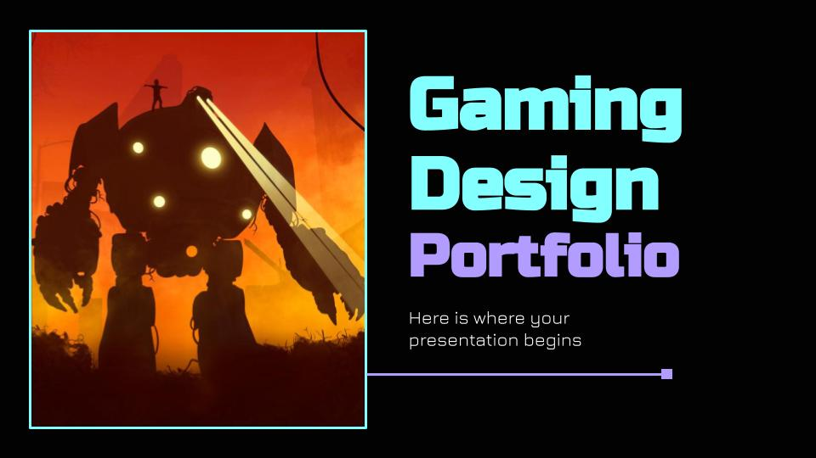
Computer
mockup
You can replace the image on the screen with your own work. Just right-click on it and select “Replace image”

Slide 29
Use a map
Mars
Mars is actually a very cold place
Neptune
It’s the farthest planet from the Sun

Slide 30
Examples of projects
Name | Explication | Review
Mercury is the closest planet to the Sun | This planet's name has nothing to do with the liquid metal | “Mercury is quite small” —Mike Doe
Venus is the second planet from the Sun | Venus is terribly hot, and its atmosphere is extremely poisonous | “Mars is a red planet” —Beth Bones
Jupiter is a gas giant and the biggest planet | Jupiter is the fourth-brightest object in the night sky | “The Sun is a big star” —Matt Path

Slide 31
Game design creation process
Venus
Venus is the second planet from the Sun
Mars
Mercury
Mars is actually a very cold place
It’s the closest planet to the Sun
Step 02
Step 01
Step 03

Slide 32
Contact
Do you have any questions?
youremail@freepik.com
+91 620 421 838
yourwebsite.com
Please keep this slide for attribution

Slide 33
Icon pack

Slide 34
Alternative resources
Here’s an assortment of alternative resources whose style fits that of this template:
Photos
Medium shot man with vr glasses
Portrait of beautiful female photographer in the city at night
Sportsman sitting and looking at camera at football
Medium shot couple playing videogame in bed
Man playing game on computer medium shot
Medium shot woman with vr glasses on couch

Slide 35
Resources
Did you like the resources on this template? Get them for free at our other websites:
Vectors
Futuristic dark gaming youtube channel art
Photos
Robot and human silhouettes
Abstract fantasy landscape background
Colleagues working at office
Dragons and fantasy artificial intelligence image
Mars collage with explorer discovering the planet
Industrial designer working on computer at office
Abstract fantasy landscape background
Dragons and fantasy artificial intelligence image
Mars collage with explorer discovering the planet
Industrial designers working at office together
Robot and human silhouettes
Dragons and fantasy artificial intelligence image
Dragons and fantasy artificial intelligence image
Mars collage with explorer discovering the planet I
Top view gaming setup with rgb keyboard
Icons
Icon Pack: Online Game | Lineal

Slide 36
Instructions for use
If you have a free account, in order to use this template, you must credit Slidesgo by keeping the Contact slide. Please refer to the next slide to read the instructions for premium users.
As a Free user, you are allowed to:
- Modify this template.
- Use it for both personal and commercial projects.
You are not allowed to:
- Sublicense, sell or rent any of Slidesgo Content (or a modified version of Slidesgo Content).
- Distribute Slidesgo Content unless it has been expressly authorized by Slidesgo.
- Include Slidesgo Content in an online or offline database or file.
- Offer Slidesgo templates (or modified versions of Slidesgo templates) for download.
- Acquire the copyright of Slidesgo Content.
For more information about editing slides, please read our FAQs or visit Slidesgo School:
https://slidesgo.com/faqs and https://slidesgo.com/slidesgo-school

Slide 37
Instructions for use (premium users)
As a Premium user, you can use this template without attributing Slidesgo or keeping the "Contact" slide.
You are allowed to:
Modify this template.
Use it for both personal and commercial purposes.
Hide or delete the “Thanks” slide and the mention to Slidesgo in the credits.
Share this template in an editable format with people who are not part of your team.
You are not allowed to:
Sublicense, sell or rent this Slidesgo Template (or a modified version of this Slidesgo Template).
Distribute this Slidesgo Template (or a modified version of this Slidesgo Template) or include it in a database or in any other product or service that offers downloadable images, icons or presentations that may be subject to distribution or resale.
Use any of the elements that are part of this Slidesgo Template in an isolated and separated way from this Template.
Register any of the elements that are part of this template as a trademark or logo, or register it as a work in an intellectual property registry or similar.
For more information about editing slides, please read our FAQs or visit Slidesgo School:
https://slidesgo.com/faqs and https://slidesgo.com/slidesgo-school

Slide 38
Fonts & colors used
This presentation has been made using the following fonts:
Russo One
(https://fonts.google.com/specimen/Russo+One)
Jura
(https://fonts.google.com/specimen/Jura)
#020202
#ffffff
#ff5e68
#ff0013
#ff0b0b
#82fffe
#b29cff
##b29cff
#04cfcf
#00fffe

Slide 39





Storyset
Create your Story with our illustrated concepts. Choose the style you like the most, edit its colors, pick the background and layers you want to show and bring them to life with the animator panel! It will boost your presentation. Check out how it works.
Pana
Amico
Bro
Rafiki
Cuate

Slide 40
Use our editable graphic resources...
You can easily resize these resources without losing quality. To change the color, just ungroup the resource and click on the object you want to change. Then, click on the paint bucket and select the color you want. Group the resource again when you’re done. You can also look for more infographics on Slidesgo.

Slide 43
JANUARY
FEBRUARY
MARCH
APRIL
MAY
JUNE
PHASE 1
Task 1
Task 2
PHASE 2
Task 1
Task 2
JANUARY
FEBRUARY
MARCH
APRIL
PHASE 1
Task 1
Task 2

Slide 46
...and our sets of editable icons
You can resize these icons without losing quality.
You can change the stroke and fill color; just select the icon and click on the paint bucket/pen.
In Google Slides, you can also use Flaticon’s extension, allowing you to customize and add even more icons.

Slide 47
Educational Icons
Medical Icons

Slide 48
Business Icons
Teamwork Icons

Slide 49
Help & Support Icons
Avatar Icons

Slide 50
Creative Process Icons
Performing Arts Icons

Slide 51
Nature Icons

Slide 52
SEO & Marketing Icons

Slide 53


